Slide 1
What happens when a King dies or
loses his throne and other people
want to be King?

Slide 2
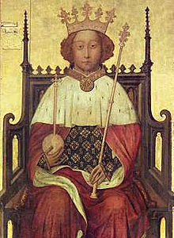
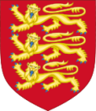
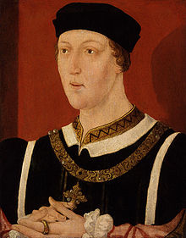
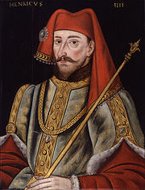
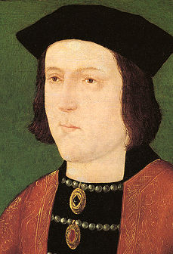
Richard II
( Boy King in Peasants Revolt)
Lost his throne to his Cousin Henry IV in September 1399
Henry VI
(Grandson of Henry IV)
Rumoured to be mad, his Kingdom was frequently ran by regents
(people put in charge in Kings absence)
Became King 1422
Henry IV
Henry “Bolingbroke” (he was born there)
First Lancaster King of England.
Edward IV
Became King in 1460. Led an uprising against the King and took the throne.
First York King of England
Did you know? Shakespeare’s play Richard II is about Richard losing the throne to Henry Bolingbroke.
Kings are numbered using Roman Numerals our current Queen is Elizabeth II ( the second)
IV means 4th. V means 5th and VI means 6th.

Slide 3
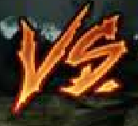
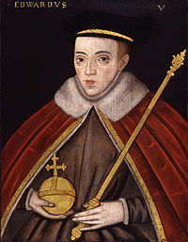
Henry VI
Edward IV
Henry VI took the throne back from Edward IV in 1470
Edward IV won the throne back in 1471
Edward IV dies in 1483 and is replaced by his son, Edward V.
Edward V
Edward is King at age 12, but was never crowned.....

Slide 4
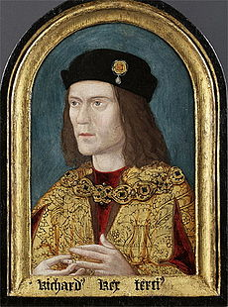
Edward V
Edward V on travelling to be crowned King is met by his regent and uncle Richard.
His fathers marriage is declared invalid and Edward V and his brother are declared illegitimate.....
What does this mean in terms of being King?
Richard III
Locked Edward V and his brother in the tower of London. The two princes disappeared.....
Richard becomes King Richard III in 1483.
Did you know? Shakespeare’s wrote a play about this as well !
Richard III was a hunchback or had a curved spine.
Richard III body was found in 2012, buried under a car park in Grey friars Leicester.

Slide 5
The White Rose of York
The Red Rose of Lancaster.
Both branches of the Plantagenet family but considered separate dynasties.
Dynasty = a bloodline or line of rulers.
ALL : Copy out chronological time line of the Kings mentioned in today's lesson into your book. List one key point about each person.
Gold: With York and Lancaster fighting for the Throne of England what or who do you think could bring these families back together?
Silver: What exactly do you think happened to Prince Edward V and his brother in the Tower of London?
Bronze: Draw and colour the White and Red Roses of York and Lancaster. Which family was the most powerful and why?

Slide 6
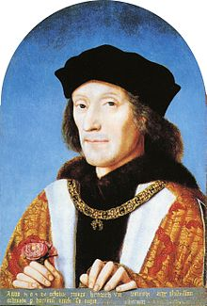
Henry VII
Last surviving Lancaster male.
Held a very slight claim to the throne based around his mother.
(She was a cousin of Henry VI)
Henry VIII got support from the York forces to raise and army and try to take the throne from Richard III.
How did Henry VII a Lancaster get support from York to remove a York King ??
Richard III was very unpopular. Henry VII had agreed to marry Elizabeth of York ( technically his cousin) if crowned King. Elizabeth of York was sister to Edward V ( the Prince in the Tower) making Elizabeth technically the rightful heir to the throne !

Slide 7
1485. Lancaster meets York at the Battle of Bosworth Field.
What do you think the outcome will be?

Slide 8
Henry VII’s claim
Mother was cousin to a former King.
Current King Richard III was hated by the people.
Made a deal to marry Elizabeth of York.
Elizabeth of York was the sister of Edward V.
This made her the rightful heir to the throne.
Henry VII’s claim
Mother was cousin to a former King.
Current King Richard III was hated by the people.
Made a deal to marry Elizabeth of York.
Elizabeth of York was the sister of Edward V.
This made her the rightful heir to the throne.

Slide 9
Plantagenet: Former ruling family of England
House of Lancaster : A cadet branch or offshoot of the Plantagenet's based in Lancaster
House of York: A cadet of offshoot of the Plantagenet's based in Lancaster
Dynasty: A bloodline of kings or rulers
Regent: Someone who rules in place of the King if he's not able to rule himself
Roman Numerals: Numbers used to show a King or Queen with the same name as one held before. IV= 4th V = 5th VI =6th VII = 7th
Illegitimate: The son or daughter is not considered King or Queen.
Heir: Next in line for the throne
Plantagenet: Former ruling family of England
House of Lancaster : A cadet branch or offshoot of the Plantagenet's based in Lancaster
House of York: A cadet of offshoot of the Plantagenet's based in Lancaster
Dynasty: A bloodline of kings or rulers
Regent: Someone who rules in place of the King if he's not able to rule himself
Roman Numerals: Numbers used to show a King or Queen with the same name as one held before. IV= 4th V = 5th VI =6th VII = 7th
Illegitimate: The son or daughter is not considered King or Queen.
Heir: Next in line for the throne

