Slide 1
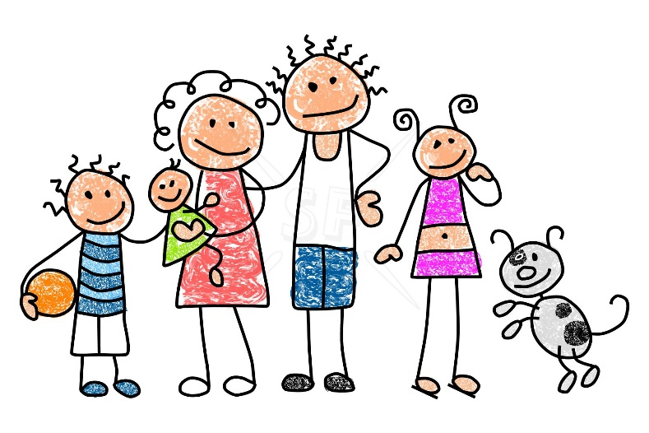
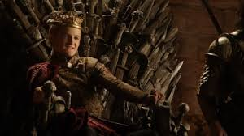
Starter: If 2 different families wanted to be the king, how might they settle the argument?

Slide 2
Title: What was the War of the Roses?
25 June 2014
Learning Objective:
To investigate the events of the ‘War of the Roses’.
House of York
Key Words : House of York + Lancaster/ Civil War / Rivalry
House of Lancaster
Learning Outcomes:
Good: To identify and describe the main people involved in the War of the Roses. L4
Great: To explain which house was in the better position by 1485. L5
Awesome: To evaluate which house deserved to win the War of the Roses. L6

Slide 3
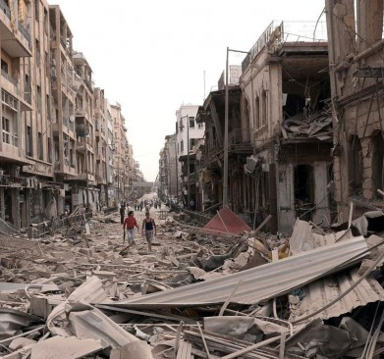
Intro: What does a Civil War look like?
Level 4: Describe what you can see happening in the video.
Level 5: Explain how the people in Syria might feel about the civil war.
Level 6: Explain why the civil war is bad for the people of Syria.
Notes:
http://www.youtube.com/watch?v=DhSeT51bm-A
link to Syrian Civil War

Slide 4
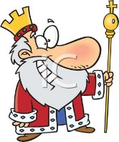
Living Graph – Who won the War of the Roses?
House of Lancaster winning
1. Henry VI is king of England between 1422-61. He was slightly insane.
1485
1455
Complete these sentences:
A high point for the House of Lancaster was ___ because ____
A low point for the House of Lancaster was ___ because ____
The dynasty that deserved to win the ‘War of the Roses’ was ___ because ____
EXT: Who were the heroes and villains of the War of the Roses?
House of York winning

Slide 5
RECAP
Learning Outcomes:
Good: To identify and describe the main people involved in the War of the Roses. L4
Great: To explain which dynasty was in the better position by 1485. L5
Awesome: To evaluate which dynasty deserved to win the War of the Roses. L6

Slide 6
Plenary: Would you like to know more?
Which event from the War of the Roses would you like to learn more about and why?
??????

