Slide 1
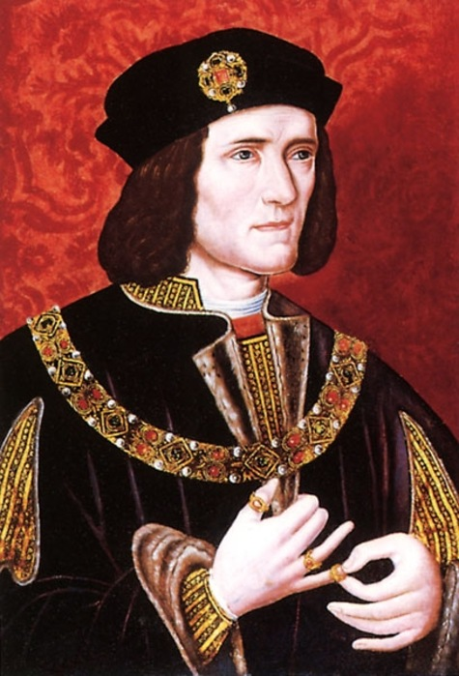
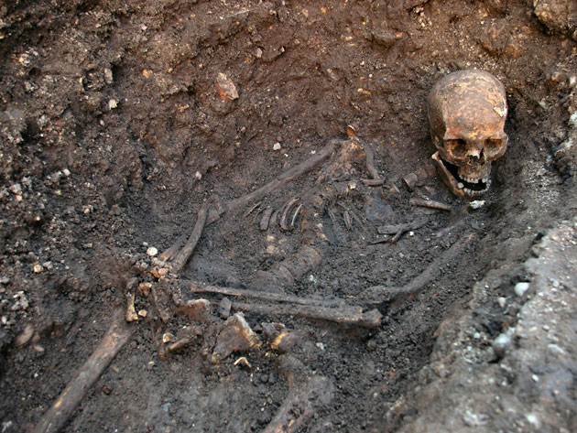
King Richard III was found under a car park in Leicester.

Slide 3
Who was Richard III?
Lesson Aims
Describe the War of the Roses (Level 4)
Create a profile about Richard III which explains an overview of his life supported by detail. (level 5&6)

Slide 4
How did Richard III become King?
In 1453, England faced a serious problem: King Henry VI was suffering from a bout of madness. He had lost his memory and would sit silently in the corner of a room for hours on end.
For the powerful York family, this latest episode of insanity was a step to far. They thought that they had a strong claim to the throne and that they could run the country better. They were prepared to plunge the country into civil war!
V

Slide 5
Who ruled before Richard III?
1422 1483

Slide 6
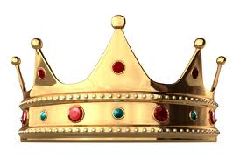
Who ruled before Richard III?
Edward IV
1461-70
Edward IV
1471-83
Edward V
1483
Richard III
1483-85
1422 1485
Henry VI
1422-61
Henry VI
1470-71

Slide 7
Who was Richard III?
Your Task
Read through the information about Richard III.
Create a Facebook page for Richard III.

Slide 9
Final Thought
Write down three things you have learnt today.

