Slide 1
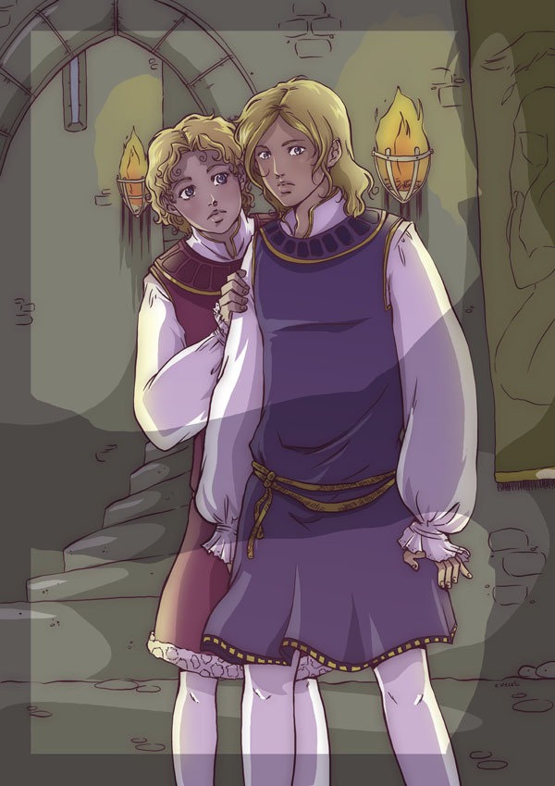
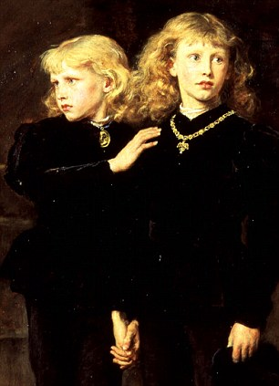
What happened to the Princes in the Tower?
SMSC Social and Cultural Question – Using these pictures, try to describe the fashion for boys at this time?
Challenge – Do you think these pictures are truthful?

Slide 2
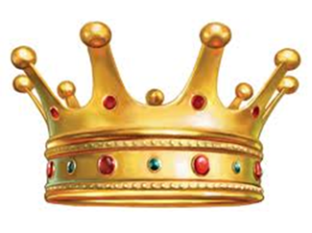
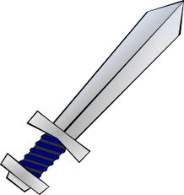
In April 1483, the boys’ father died suddenly.
Numeracy – Which century is this?
Challenge - Can you work out what this death means to one of the boys in particular? (Do any of the picture clues help you?)
Prince Edward, aged 12 and Prince Richard, aged 9.

Slide 3
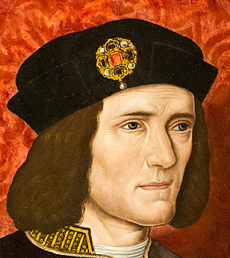
Richard, Duke of Gloucester, the boys’ uncle, was given the job of protecting the princes and helping young Edward until he was old enough to rule England on his own.
However, there was a problem! The Duke of Gloucester was a jealous man and wanted to be King.
Literacy – Write a definition for the word ‘jealous’ in 10 words or less.

Slide 4
Richard, Duke of Gloucester, crowned himself King Richard III of England in July 1483.
This is where our mystery begins, because the two princes he was supposed to be protecting had vanished into thin air.
Or had they?...
What might the people of England think?
Challenge - What do you know about Richard III?
Why has he been in the news recently?

Slide 5
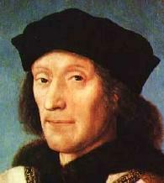
This is Henry Tudor, the sworn enemy of King Richard III.
Literacy – What does ‘enemy’ mean?
SMSC Moral Question – Can you name a pair of enemies from a book or film? Whose side are you on and why?

Slide 6
Henry Tudor fought King Richard III at the Battle of Bosworth in 1485.
Henry Tudor won and became King Henry VII.
Challenge – Who do you think was his very famous son?
But some people of England thought Henry killed the Princes in the Tower...

Slide 7
King Richard III
King Henry VII
Divide your page into 2 columns, one for each of these kings.
Can you write a sentence about each man using the correct words from below?
Protect
Enemy
Jealous
Battle
Tudor
Uncle

Slide 8
King Richard III
King Henry VII
So, who killed the Princes in the Tower?
You need to look at the evidence and try to solve the mystery!

Slide 9
Source A
Richard took Prince Edward and his brother to the Tower, and day by day they began to be seen less behind bars and windows, until they were seen no more.
Written by an Italian man in 1483. His English wasn’t very good.
Source B
Richard had no reason to kill the boys. Henry had every reason. Henry was responsible for the crime, so they were quietly murdered.
Written by historian Phillip Lindsay in 1972.
Source D
Henry Tudor gave important jobs to Tyrell, Dighton and Forest.
Anonymous source.
Source E
Neither Henry nor the boys’ mother ever blamed Richard in public after his death.
Modern website 2013
Source C
King Richard ordered men called Tyrell, Dighton and Forest to smother the boys with pillows whilst they were sleeping.
Written in 1513 by Sir Thomas More, a man who hated Richard.
Select sources for each side of the case.
Are they reliable? Use the 5W’s to decide!

Slide 10
King Richard III
King Henry VII
Source A
Richard took Prince Edward and his brother to the Tower, and day by day they began to be seen less behind bars and windows, until they were seen no more.
Written by an Italian man in 1483. His English wasn’t very good.
Source B
Richard had no reason to kill the boys. Henry had every reason. Henry was responsible for the crime, so they were quietly murdered.
Written by historian Phillip Lindsay in 1972.
Source D
Henry Tudor gave important jobs to Tyrell, Dighton and Forest.
Anonymous source.
Source C
King Richard ordered men called Tyrell, Dighton and Forest to smother the boys with pillows whilst they were sleeping.
Written in 1513 by Sir Thomas More, a man who hated Richard.
Source E
Neither Henry nor the boys’ mother ever blamed Richard in public after his death.
Modern website 2013

Slide 11
Who is the murderer?
You now need to decide who you think killed the two Princes.
Who do you think is responsible?
Why did this man kill the Princes?
Which evidence backs up your opinion?
What makes you think this evidence is reliable?

Slide 12
Writing frame
Level 3
Identify, understand, use sources.
I think the Princes were killed by…
He wanted them dead because…
The sources that support this view are…
Source __ says “…”
Level 4
Describe, select, quote.
This links to source __ which says “…”
I trust these sources because…
Level 5
Explain, make links, compare.

Slide 13
Level 3
Identify, understand, use sources.
I think the Princes were killed by…
He wanted them dead because…
The sources that support this view are…
Source __ says “…”
Level 4
Describe, select, quote.
This links to source __ which says “…”
I trust these sources because…
Level 5
Explain, make links, compare.
I think certain sources support my view because…
The other side of the argument is weak because…
Level 6
Examine, explain links analyse.

Slide 14
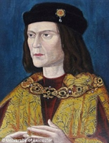
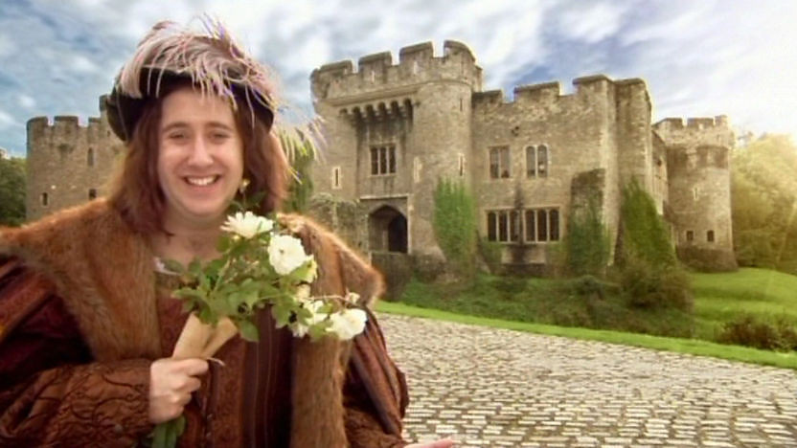
What do you think about Richard III?
What can you add to Richard’s Top Trump card?
Richard III 1483-1485
Was he – An evil man who killed his nephews so he could be King?
Or – A good king who was blamed for something he didn’t do?
Which view does Horrible Histories take?
http://www.youtube.com/watch?v=R6JczvS1PL4

