Slide 1
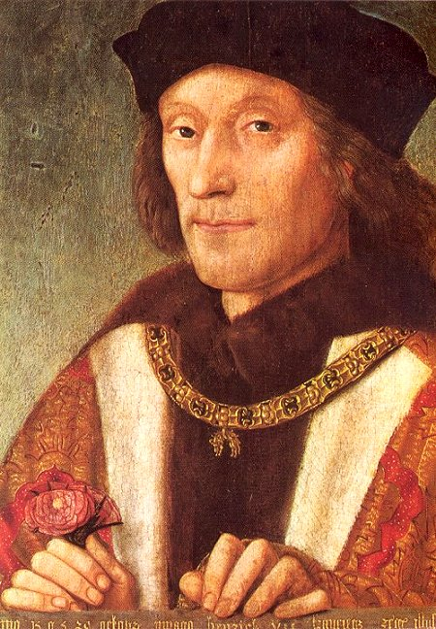
Henry VII restores order

Slide 2
Henry VII - The Wars of the Roses - pg 56
4th Jan 2011
Learning Goals
1. Read pages 66-67 Blue Key Stage 3 Book. Title – The Wars of the Roses
Answer Questions 1 and 2 from blue boxes.
2. Copy and colour Fig 1 roses from pg 56
3. Using the Green Box details – tell the story of the Battle of Bosworth Field from pg 57
4. Create a page display using all the information from the SUMMARY box from pg 57
5. Extension – Complete Battle of Bosworth challenge and
Tudor crossword please. WELL DONE!

Slide 3
Henry VII - The Wars of the Roses - pg 56
24^{hth} November 2009
Learning Goals
Explain how Henry Tudor became king Henry VII.
Answer Questions 1 and 2 from blue boxes.
2. Copy and colour Fig 1 roses from pg 56
3. Explain how Henry dealt with issues of (i) nobles (ii) money (iii) trade and (iv) foreign countries pg 63
3. Using the Green Box details – tell the story of the Battle of Bosworth Field from pg 57
4. Extension – Complete Battle of Bosworth challenge and
Tudor crossword please. WELL DONE!

Slide 4
Henry VII - The Wars of the Roses - pg 56
4th Jan 2011
Learning Goals
Read the story about Henry VII carefully – both sides.
Answer Questions 1 to 8 from Task 1 – copy the questions.
2. Copy and colour Fig 1 roses from pg 56 – BLUE book
3. Complete Activity 4 and 5 from your A3 sheet
4. Extension – Sketch King Henry VII – there is a picture on your A3 sheet. WELL DONE!
5. Tudor monarchs crossword

Slide 5
Learning Goals
To know who were the Tudors & what was expected of a Monarch.
To understand the importance of a single event in the past such as the Battle of Bosworth. To understand what is meant by the Tudor monarchy.
To know who Henry VII was and how he restored order in England after the Wars of the Roses.
To understand the concept of change.

Slide 6

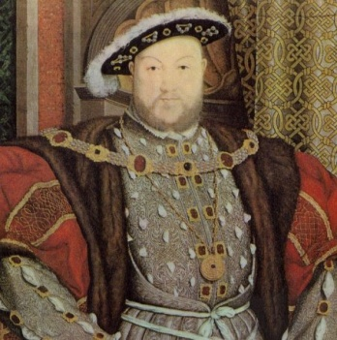
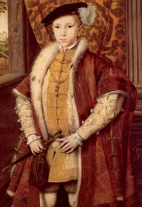
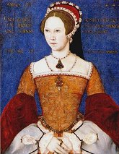
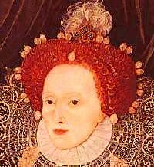
The Tudor Monarchs
Henry VII 1485-1509
Henry VIII 1509 - 1547
Edward VI
1547 - 1553
Elizabeth I
1558-1603
Mary I
1553 - 1558

Slide 7


What were the Wars of the Roses?
The “Wars of the Roses” was the name given to what was essentially a thirty year struggle over which side of the Plantagenet family (the name of the Royal family at that time) should rule England. It started basically because Edward III had a lot of sons who were very ambitious. They passed their ambition on to their sons who quarrelled over the throne.
The two factions (sides) were:
The House of Lancaster - represented by a Red Rose.
The House of York - represented by a White Rose.

Slide 8
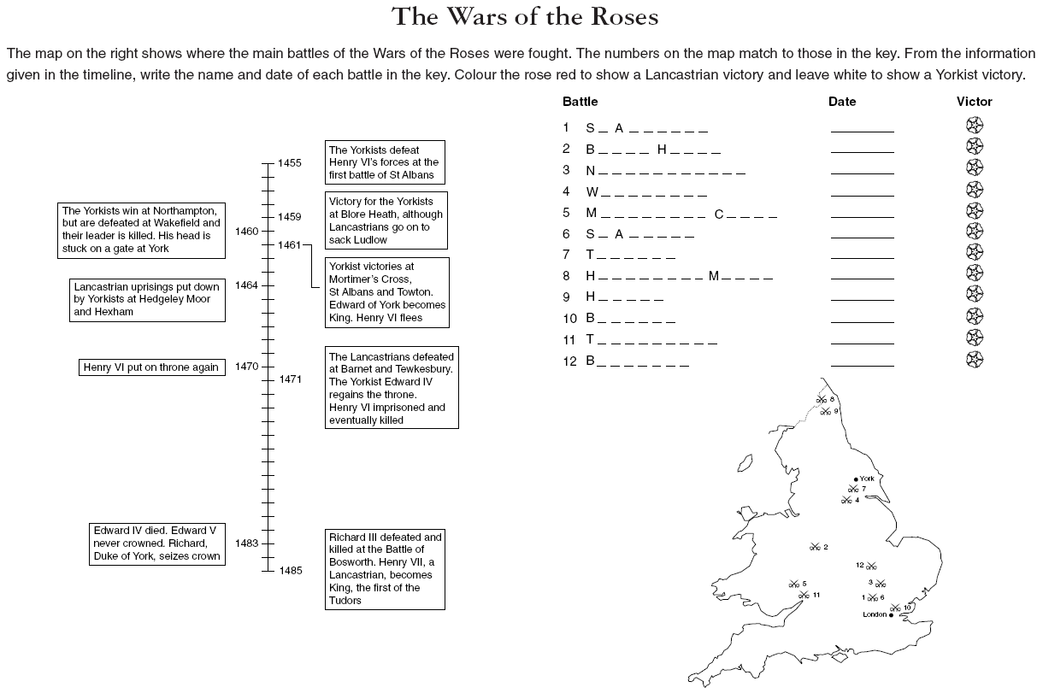

Slide 9
Answers
Problem Solution
2 14
3 1
4 8
5 9
7 10
13 11
6 12

Slide 12
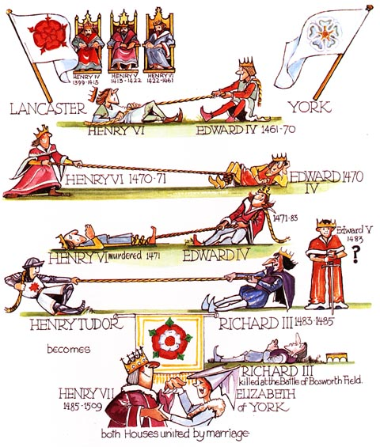

Slide 13
This is what Sir Thomas More wrote about the murder of the two princes.
Richard was a little man, with a crooked back. His left shoulder was much higher than his right. He had a hard cruel face. He was bad-tempered, jealous and dishonest. He pretended to be friendly to men he was planning to kill. People say that he killed Henry VI with his own hands when he was a prisoner in the Tower.
Sir James Tyrell decided that the princes should be murdered in their own beds. He told Miles Forest, who was one of the guards and who had already committed murder to take charge. He also ordered John Dighton, who was his horsekeeper to help him. The other guards were dismissed.
At about midnight, Miles Forest and John Dighton came into the chamber and suddenly picked up the Princes and wrapped them up in the bedclothes. They forced the pillows into their mouths and soon smothered them.

Slide 14
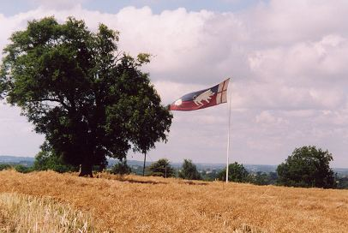
The Battle of
Bosworth Field

Slide 15
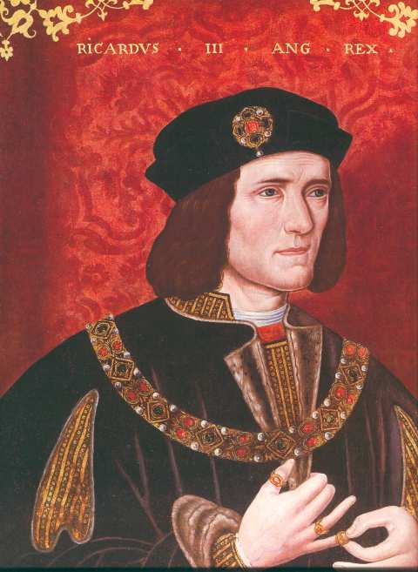
Richard III – The Last Yorkist King Of England
The last Yorkist king of England, Richard III, reigned for just two years. Some say he ruled wisely and well; others that he was a cruel tyrant who murdered his two nephews and took the crown for himself.

Slide 16
Richard III – a wicked uncle?
Edward IV died suddenly in 1483. His two sons were Edward, aged twelve, and Richard, aged nine. Before Edward IV died, he gave his younger brother, Richard, Duke of Gloucester, the job of Protector. This meant that Richard ran the country until the younger prince Edward was old enough to rule by himself. Richard of Gloucester had always been a loyal supporter of his brother Edward. He had a reputation as a good soldier and had kept law and order in the north of England where he was very popular.

Slide 17
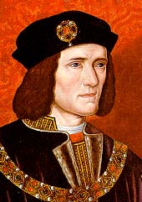
Source A
This portrait of RICHARD III was painted in Tudor times, and is probably a copy from one painted by an artist who had seen Richard.

Slide 18
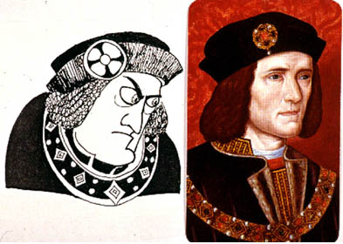
Richard III – a wicked uncle?
Then things changed. In June 1483, Richard of Gloucester announced that his brother Edward IV had never been legally married to Elizabeth Woodville. This meant their children were illegitimate, and so neither of the young princes could become king. Richard of Gloucester then took over the throne. He was crowned King Richard III in July 1483.

Slide 19

A Royal murder?
Rumours quickly spread that Richard had murdered the two princes. They had been living in the Tower of London, and the last time anyone saw them playing in the gardens was in August 1483. Two months later there was a rising against Richard. Richard got more and more unpopular. His supporters drifted away – many to support a young man called Henry Tudor, a Lancastrian.
In 1674 workmen found the bones of two boys in the Tower of London. Experts since have disagreed about whether or not they are the bones of the young princes.

Slide 20
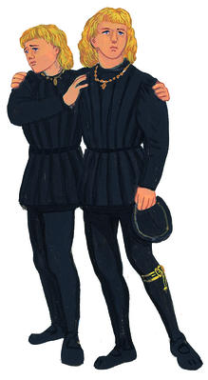
Source B
From an account of the murder of the princes, written by Sir Thomas More in 1520. He said it was part of a confession made by Sir James Tyrrel and John Dighton when they were in prison for treason.
Sir James Tyrrel was sent to Sir Robert Brackenbury, Constable of the Tower of London, with a letter from King Richard to say that he should be given all the keys of the Tower for one night. The two princes were under the care of Will Slater, called ‘Black Will’ and Miles Forest, and these two, with the groom John Dighton, smothered the two princes in their beds. Then rode Sir James to King Richard, who gave him great thanks.

Slide 21
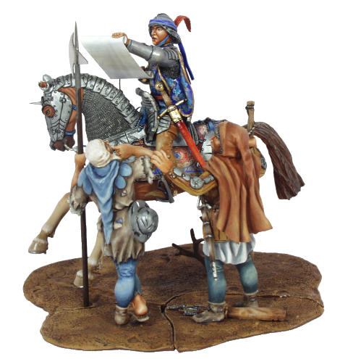
The Battle of Bosworth Field 21 August 1485
Henry Tudor decided that his time had come. He had been taken to France – and safety – by his Uncle Jasper in 1471. He learned about warfare, treachery and betrayal, court politics – and how to gain and keep supporters. In August 1485 he landed, with around 2,000 soldiers, at Milford Haven in South Wales. He was going to claim the throne of England. Slowly he advanced through Wales to the Midlands. Steadily more and more supporters joined him. By the time he reached Bosworth Field, he had an army of about 5,000 men.

Slide 22
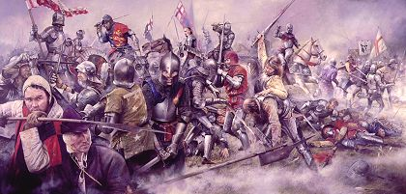
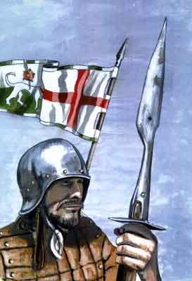
The Battle of Bosworth Field 21 August 1485
Richard had an army at least twice the size of Henry’s. However, one of his commanders, Sir William Stanley, had not decided on whose side he would fight. Together with his brother, Stanley had around 6,000 men under his command. The side on which he fought would win. Richard, of course, did not know Stanley was thinking of changing sides.

Slide 23
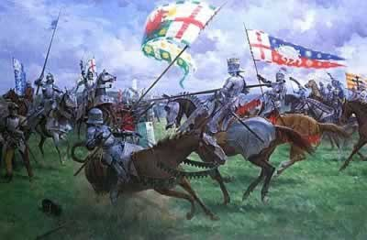
The Battle of Bosworth Field 21 August 1485
Richard’s troops took up their positions along a ridge above marshy ground. Henry’s foot soldiers advanced, and battle began. Suddenly, Sir William Stanley made up his mind. He began to fight on Henry’s side. Seeing this, Richard himself plunged into the thick of Henry’s troops. Richard’s horse galloped straight into the marsh and couldn’t struggle out. Richard leapt from the saddle. He was immediately surrounded by Henry’s men, who cut him down and killed him. It was all over. The battle had lasted less than an hour. There is a legend that says William Stanley found Richard’s crown in a thorn bush and presented it to Henry Tudor, the new king Henry VII.

Slide 24
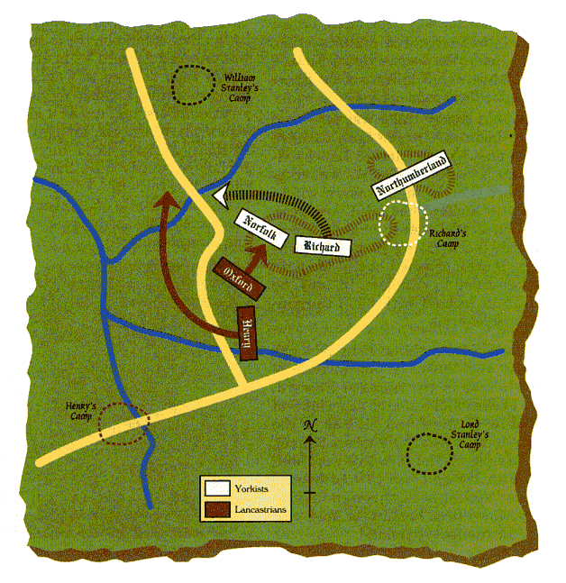

Slide 25
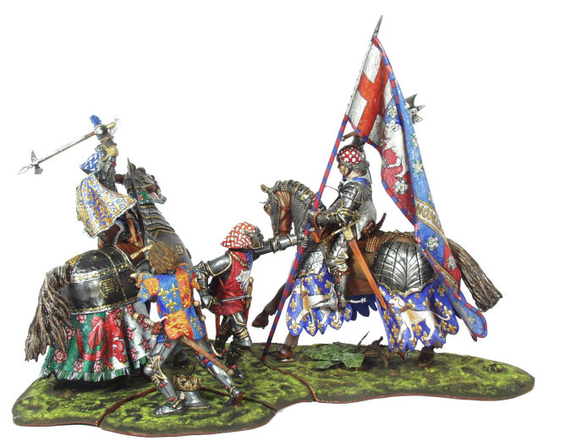

Richard III’s death at Bosworth

Slide 26
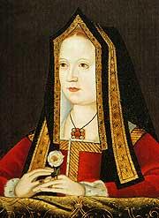
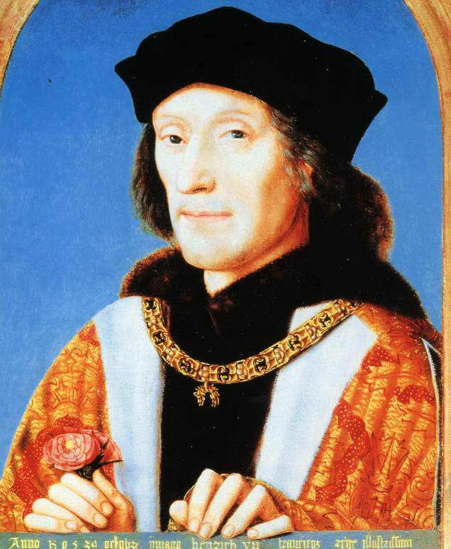
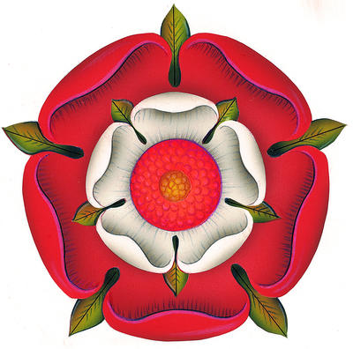

The Tudor rose is a double rose: red on the outside, white in the centre. In 1486 Henry Tudor married Elizabeth of York, Edward IV’s eldest daughter. By marrying, they joined together the Yorkists and Lancastrians. The red and white rose were one, and the Wars of the Roses were over.

Slide 27
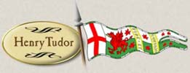
Things to do
1 Richard has been accused of murdering his nephews in the Tower of London.
a Why do you think he might have done this?
b Can you think of any reasons why it might not have been a good idea for Richard to have the princes killed?
2 a How does Source B say the princes died?
b The author of Source B was Sir Thomas More. During the reign of Henry VIII (Henry Tudor’s son) More was a senior member of the government. Do you think this might alter what he said about the death of the princes?

Slide 28
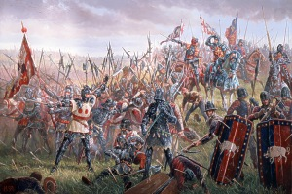

Slide 29
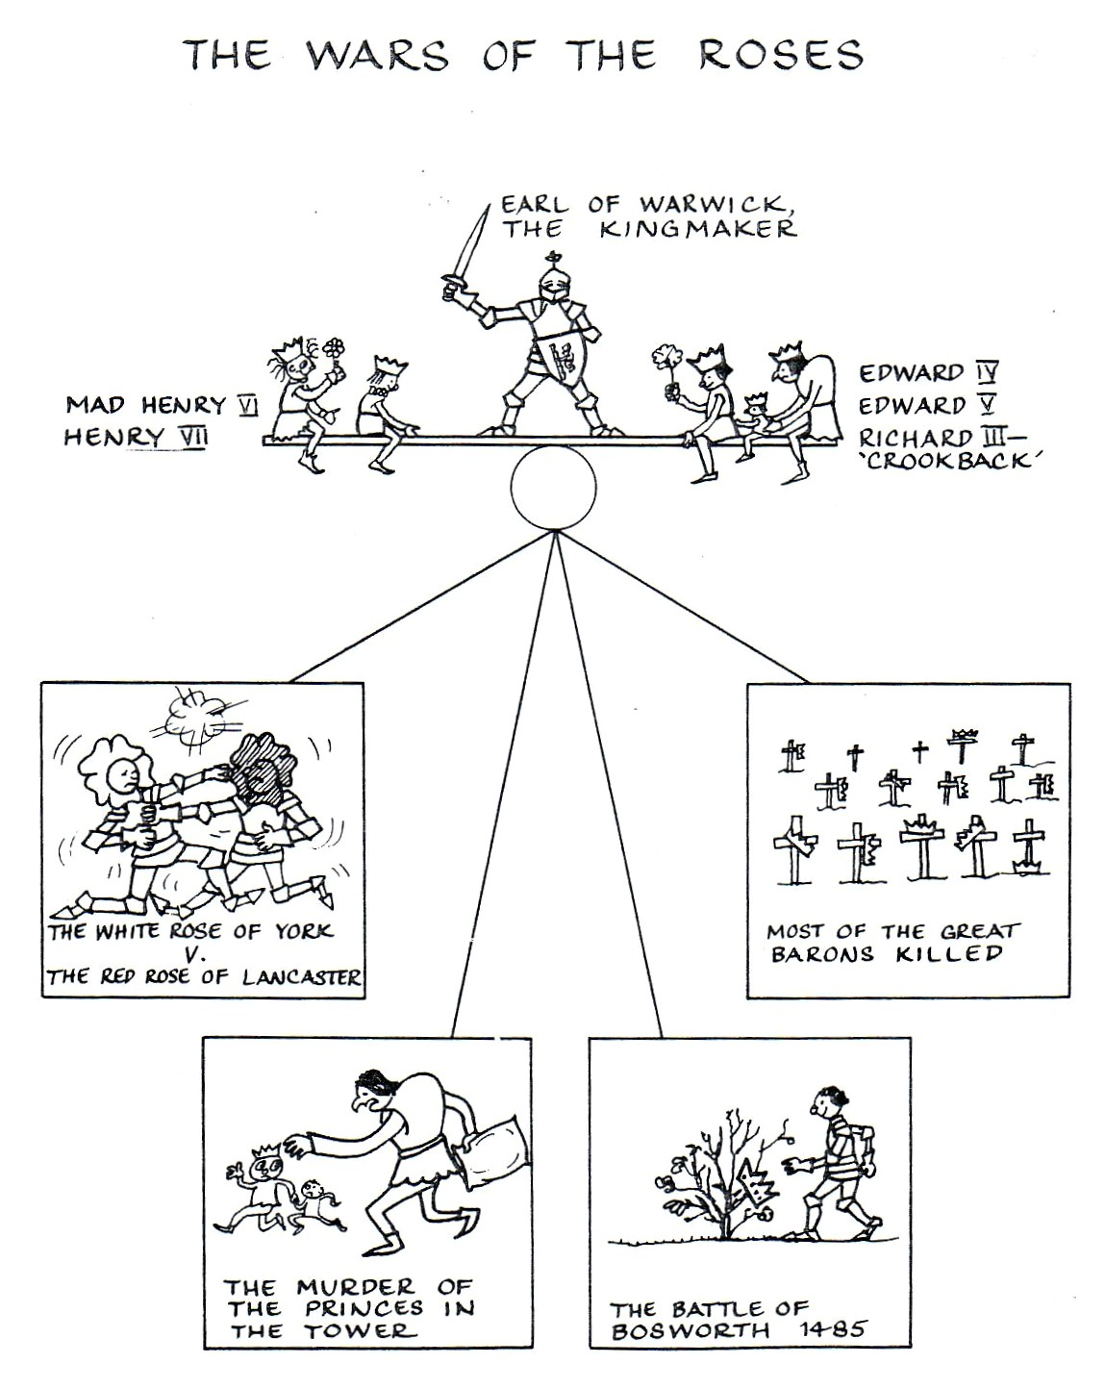
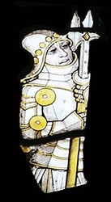

Slide 30
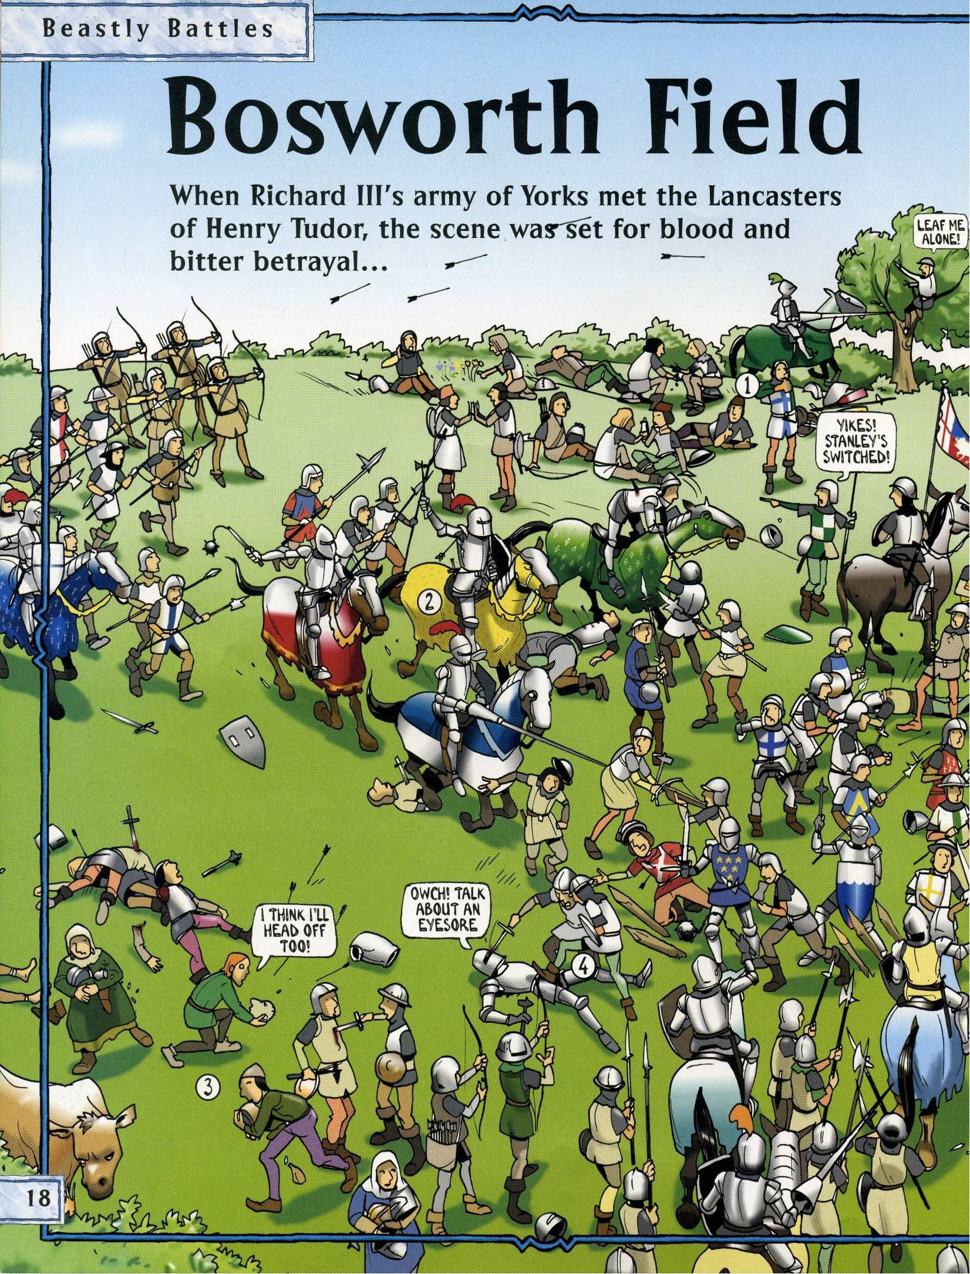

Slide 31
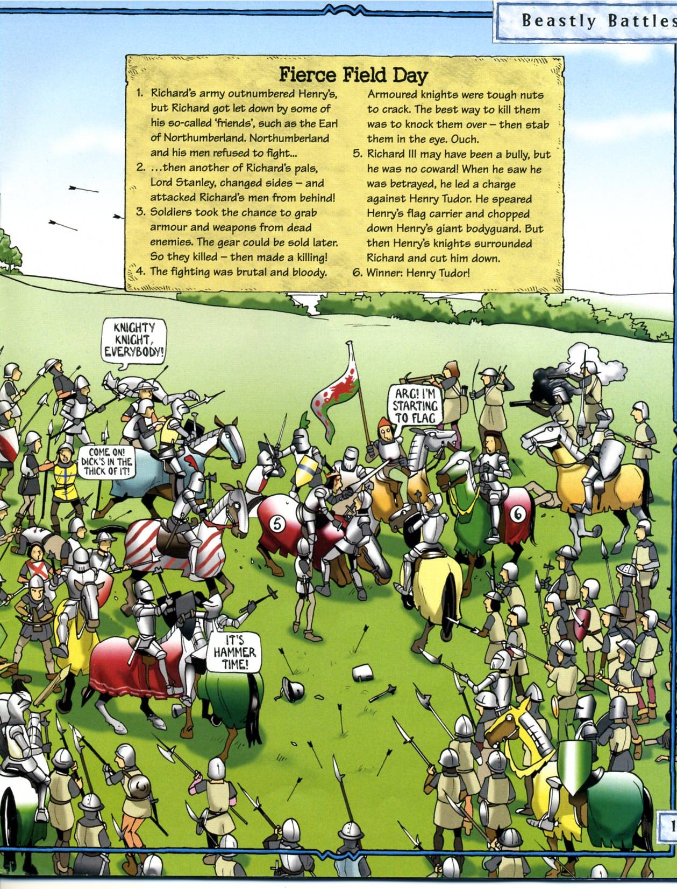

Slide 32
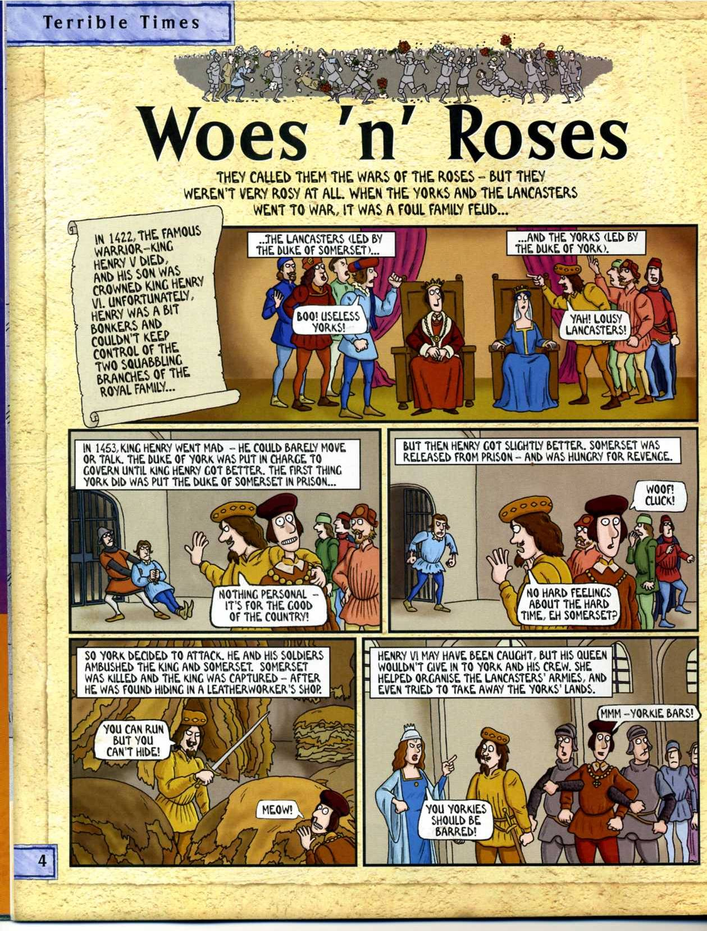

Slide 33
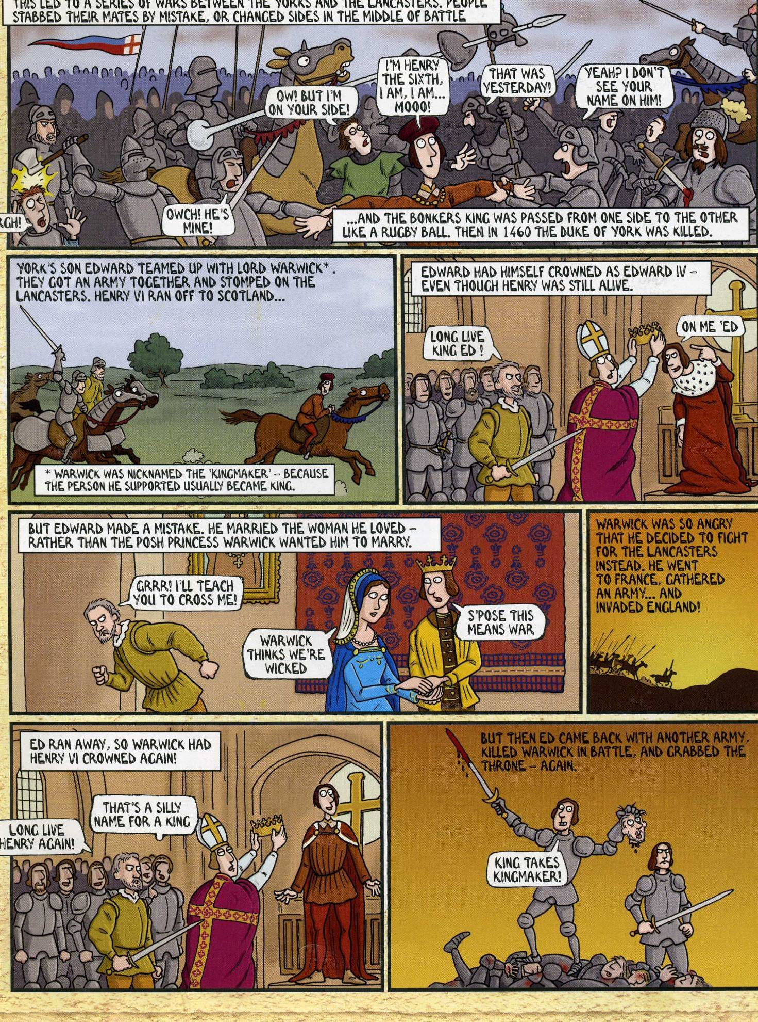

Slide 34
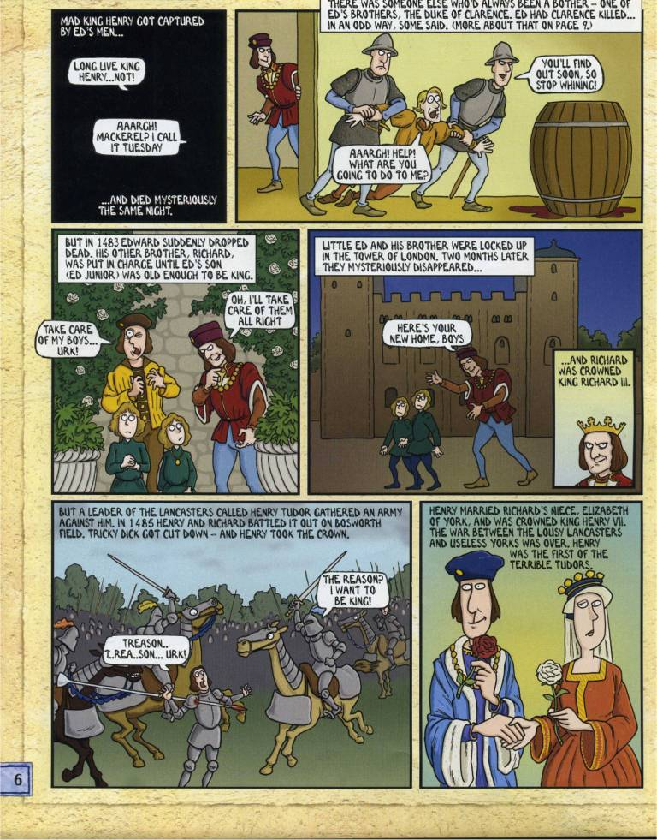

Slide 36
Find out for homework

Slide 37
Homework
Research a modern historical event from 1900 onwards where violence was a major decider in the outcome of the event.
Explain whether you think violence was the best solution in that situation.

