Slide 1
The Tudor Family Tree
Lesson Objective – To understand how the Tudor Family were related to each other.

Slide 2
Tudor family tree
Henry VII 1485–1509
Elizabeth of York
-m-
Arthur
Catherine of Aragon
Henry VIII 1509–47
Anne Boleyn
Jane Seymour
Margaret
James IV of Scotland
Mary
Duke of Suffolk
-m-
-m1-
-m2-
m3-
-m-
Louis XII of France
-m1-
-m2-
Henry Grey
-m-
Frances
Philip II of Spain
Mary I 1553–58
Elizabeth I 1558–1603
Edward VI 1547–53
-m-
Lady Jane Grey
Madeline of France
James V of Scotland
Mary of Guise
-m1-
-m2-
Anne of Cleves
-m4
Catherine Howard
-m5
Catherine Parr
-m6
Francis II of France
-m1-
Mary Queen of Scots
Lord Darnley
Lord Bothwell
-m2-
m3-
James V1 of Scotland/ I of England 1603–25
Tudor monarch Dates of reign
Notes:
Teaching Ideas
The family tree may be too detailed for the whiteboard, but could be printed out. Only English rulers have been highlighted, and the dates refer to dates of English rule. Due to space limitations, Scottish rulers’ dates aren’t included. James VI of Scotland/ James I of England is the first Stuart ruler.

Slide 3
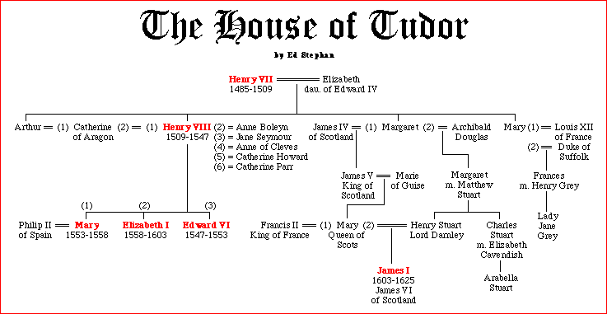
The Tudor Family Tree

Slide 4
Use the family tree to answer these questions?
Who was Catherine of Aragon married to before Henry VIII?
In which order did Henry VIII’s children become King or Queen after he died?
Why did the crown pass to King James VI of Scotland when Elizabeth died?

