Slide 1
Uniting the Kingdom
http://bit.ly/sjs6LF
Learning Objective:
What did Henry Tudor want people to think about the Tudors?

Slide 2
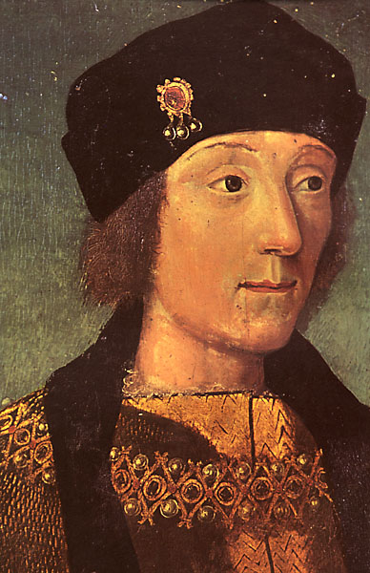
A Coat of Arms for Henry VII
Henry wants a symbol or sign to show the following:
He is the King
All of England & Wales are united
His family is strong
His family goes back a long way, giving him a strong claim
The Wars of the Roses are over (NB: No-one used the name Wars of the Roses until hundreds of years later)
Use p.8 of your textbook to help you

Slide 3
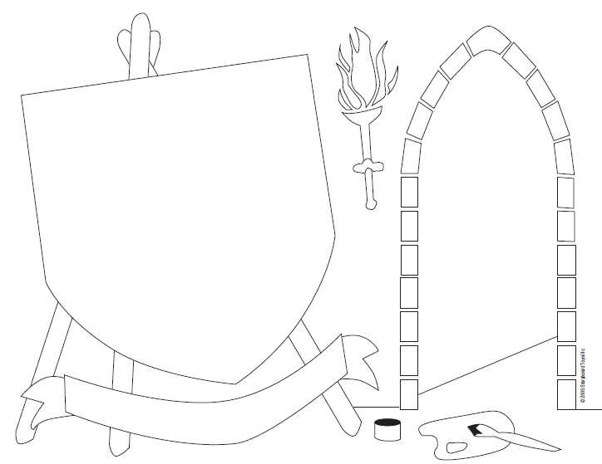

Slide 4
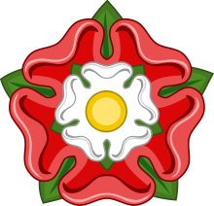
Henry Tudors had a shaky claim to the throne (based on an illegitimate Plantagenet line).
The Lancastrian King Henry VII therefore cemented his claim by marrying Elizabeth of York, the Yorkist daughter of King Edward IV.
The Houses of York (white rose) and Lancaster (red rose) thus merged, leading to the creation of the emblem called the Tudor Rose.

Slide 5
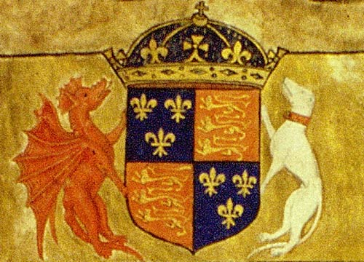
Henry used a crown imperial (arched over), indicating that he ruled over the entire realm of England and Wales. Also on the coat of arms are the white greyhound of Richmond, for his father, and the red dragon of Cadwaladr.
(Source: http://www.nationalarchives.gov.uk/utk/wales/popup/coat.htm )
Notes:
Cadwaladr of Gwynedd, the last king of the Britons, was killed in Northumbria in 682. Until his death, an ultimate British victory over the Germanic invaders was entirely possible. The memory of this alternative outcome stayed alive among the Welsh, and was as powerful as the memory of King Arthur, an earlier British fighter against the eastern invaders.

